Slide 1
Section 4.2 The Mean Value Theorem

Slide 3
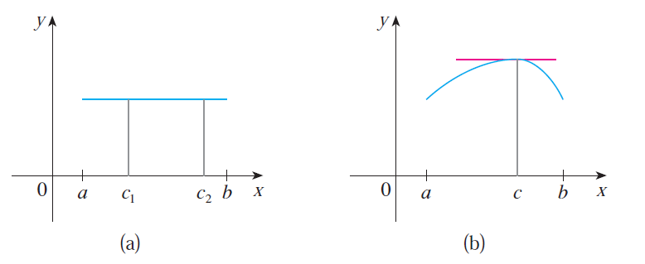
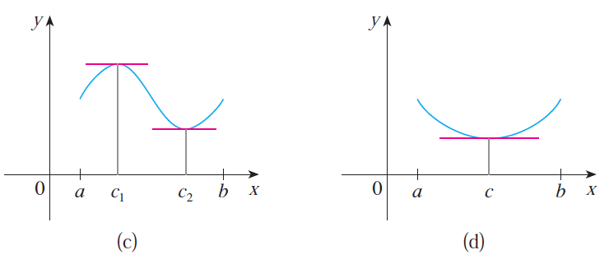

Slide 5
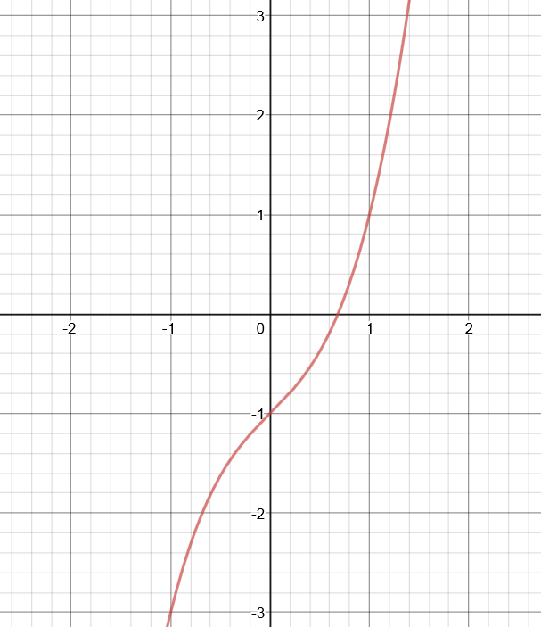
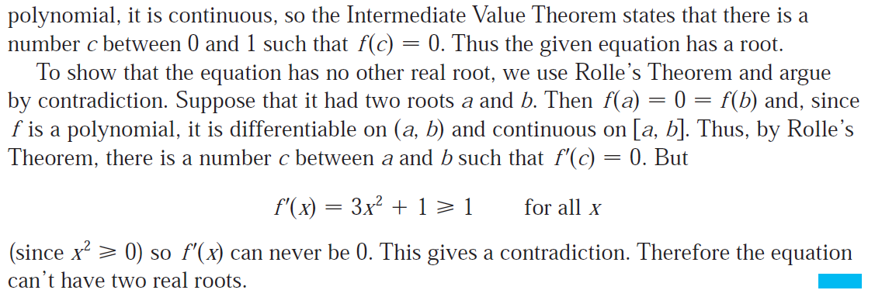

Slide 6
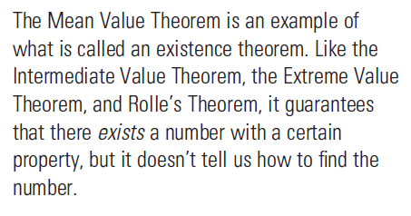

Slide 7
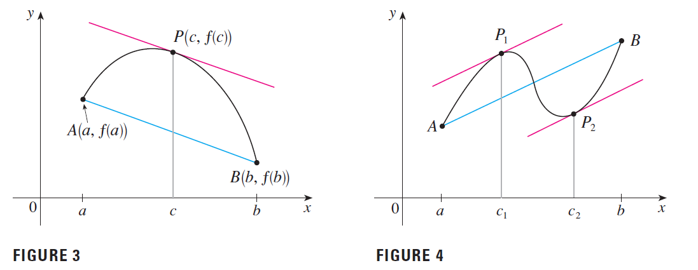
The Mean Value theorem says that at some point P between A and B, the slope of the curve is exactly equal to the slope of the secant line AB.

Slide 8
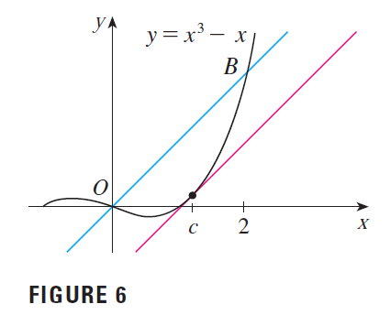

Slide 9
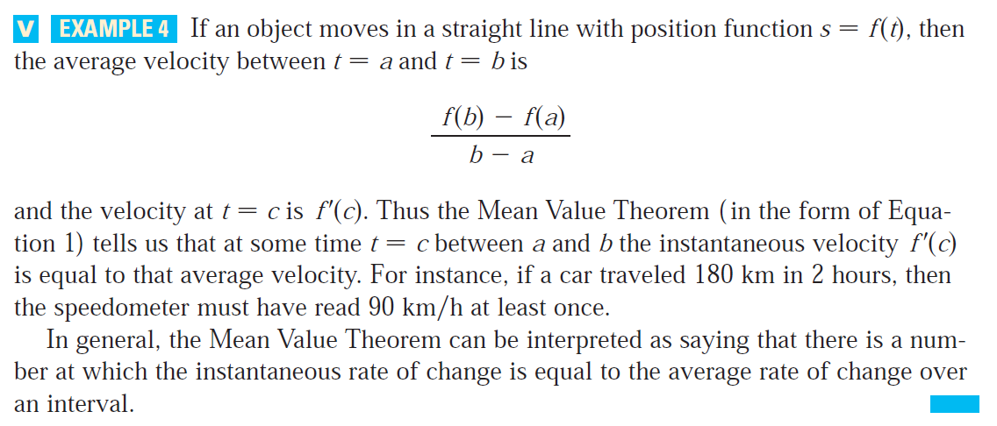

Slide 11
Exercise 25. Does there exist a differentiable function f such that f(0) = -1, f(2) = 4 and f ′(x) ≤ 2 for all x?

